Slide 1
AI Tech Infographics
Here is where the template begins
This template has been created by Slidesgo

Slide 2
Objective
Automate accurate plant disease detection.
Evaluate accuracy, efficiency, and generalizability.
Objective
Compare Custom CNN, Hybrid ML classifiers, and Pretrained models.
Identify best-performing architecture.
This template has been created by Slidesgo

Slide 3
Dtasate Details
Dataset
Size
PlantVillage (38 crop-disease categories)
~54K images
Balanced Dataset
Split
350 images per class (used in some models).
70% train, 20% validation, 10% test

Slide 4
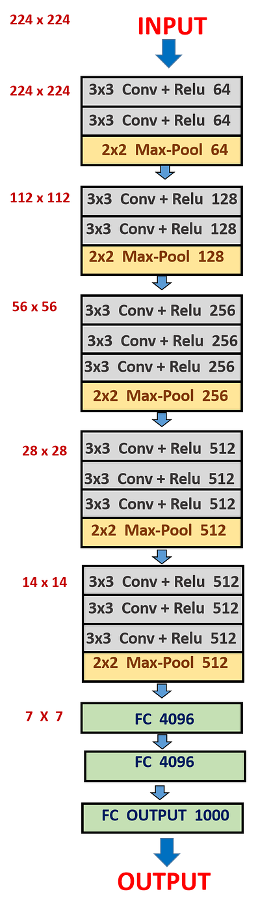
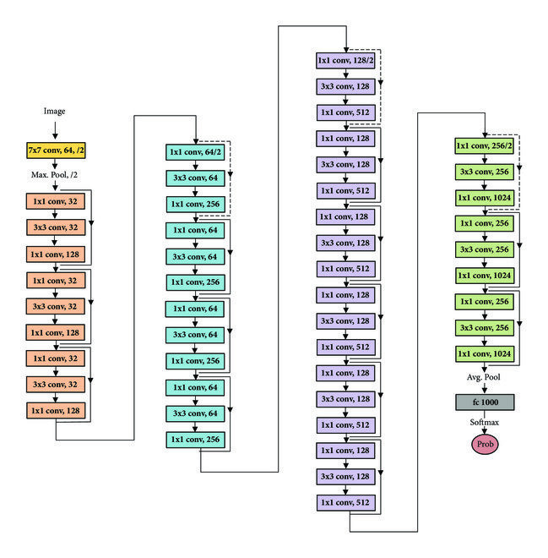
AI Tech Infographics
Resnet50
Vgg16

Slide 5
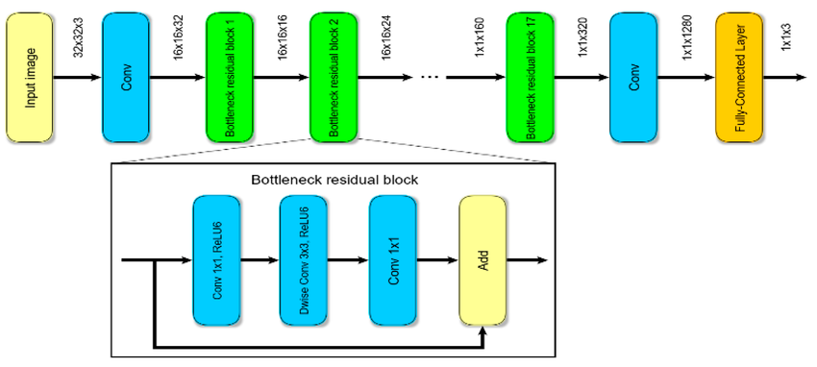
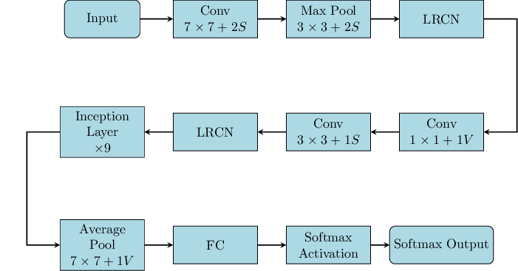
AI Tech Infographics
GoogleNet
MobileNet

Slide 6
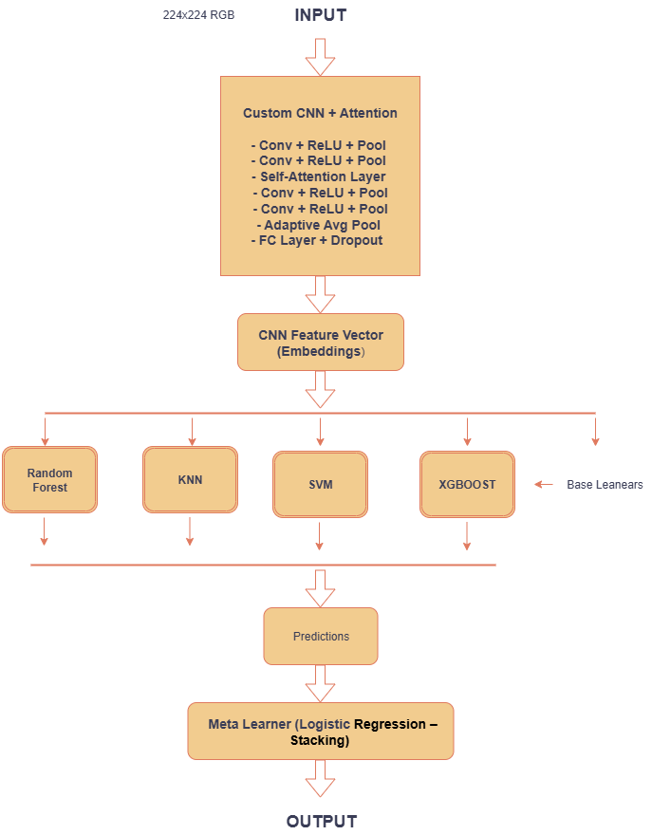
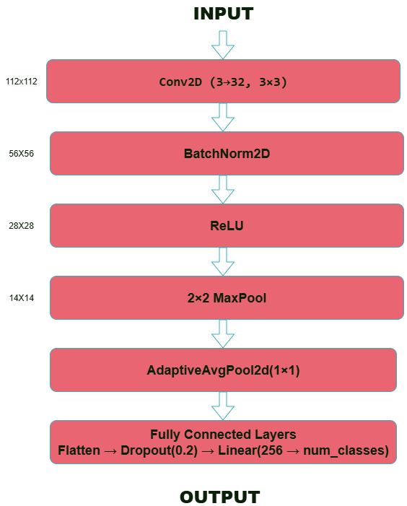
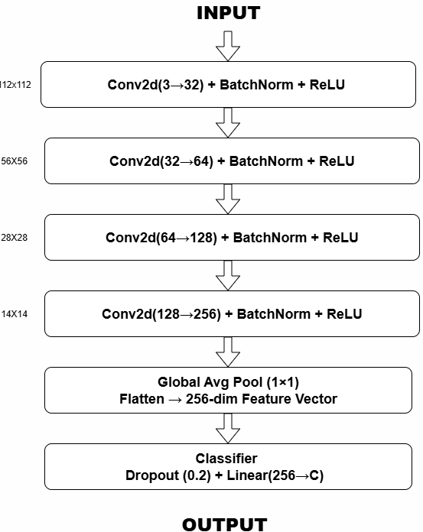
Model Architechtures
Hybrid Model
Custom CNN
CNN With
Ensemble Stacking

Slide 7
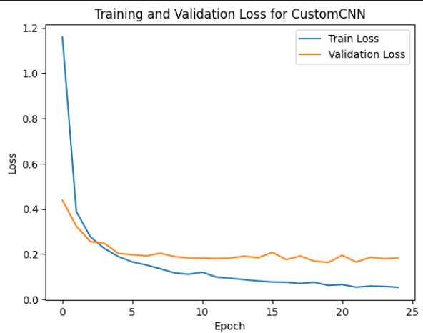
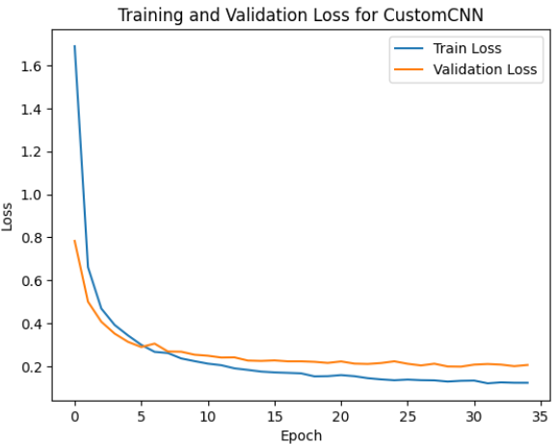
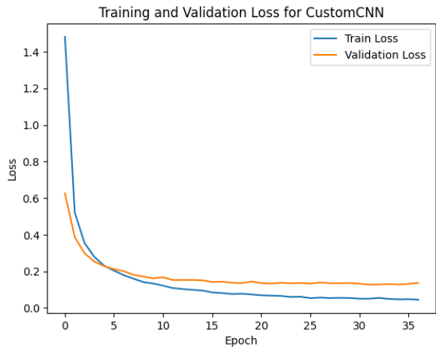
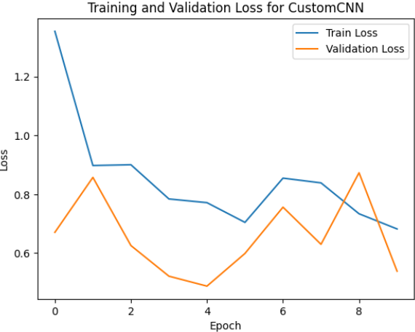
Pre-trained Model Learning Curves
MobileNet
Vgg16
Resnet50
GoogleNet

Slide 8
Model Learning Curves
Googlenet
Custom CNN
MobileNet

Slide 9
Machine Learning Parameters
01
Image size: 224×224
04
Batch size: 32.
02
Optimizer: Adam (lr ~1e-4 to 1e-3).
05
Epochs: ~50 with EarlyStopping.
03
06
Mixed Precision: Used for efficiency.
Loss: CrossEntropyLoss.

Slide 10
Finding best model
01
02
03
Highest Accuracy
Low Variance
Efficient Inference
outperforms all other models.
minimal gap between training, validation, and testing results → less overfitting.
ensemble stacking improves decision reliability without significantly increasing inference time.
04
05
Balanced Class Performance
Explainability
precision, recall, and F1-scores consistently strong across all 38 classes.
Grad-CAM visualizations confirm the model focuses correctly on diseased leaf regions.

Slide 11
Conclusion
01 | Custom CNN Ensemble Stacking achieved best accuracy.
02 | Pretrained models competitive but slightly weaker.
03 | Ensemble + attention mechanisms → strong robustness.
04 | Future work: real-time deployment on mobile devices.

Slide 12
Conclusion
The Custom CNN Ensemble Stacking model achieved the highest accuracy, clearly outperforming all other approaches. While pretrained models such as ResNet50, VGG16, MobileNetV2, and GoogLeNet delivered competitive results, they remained slightly weaker compared to the ensemble strategy. By integrating ensemble learning with attention mechanisms, the system demonstrated strong robustness and consistent performance across diverse classes. Looking ahead, future work will focus on deploying the model in real-time applications on mobile devices, enabling farmers and agricultural experts to detect plant diseases quickly and efficiently in the field.

Slide 13
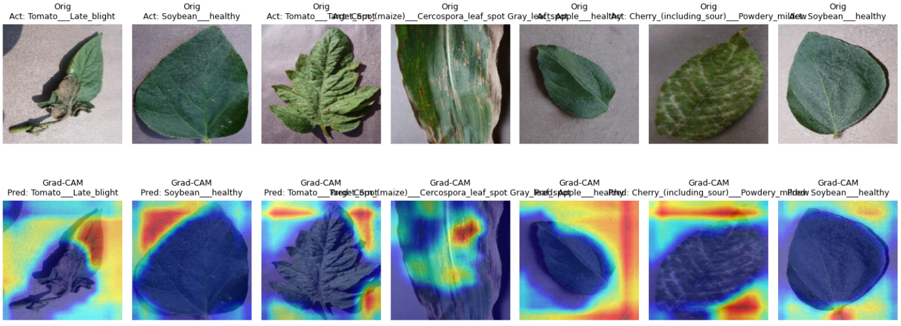
GradeCam

Slide 14
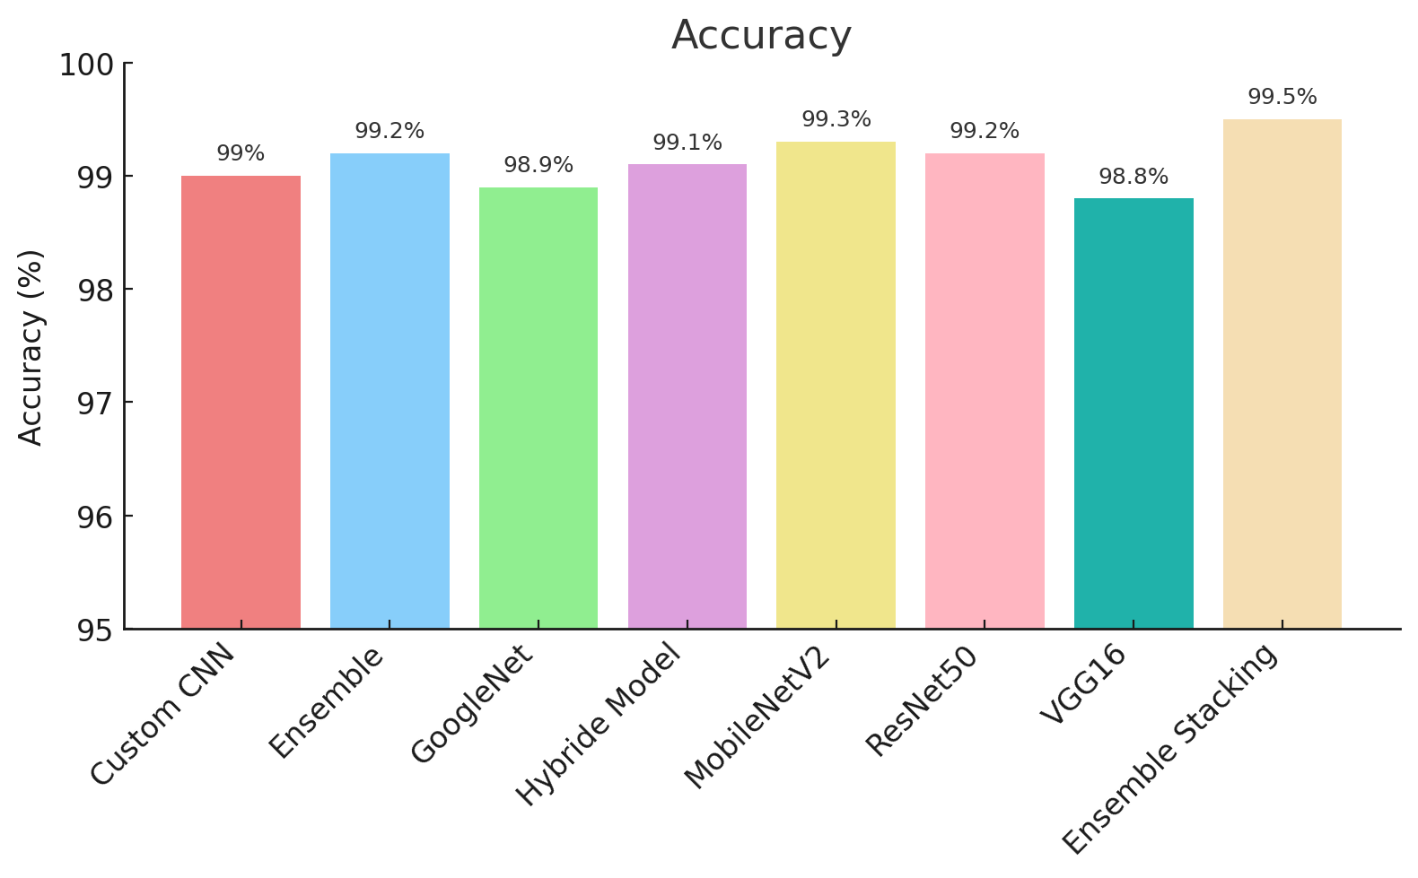
Machine Learning Infographics
01
Active learning
Mercury is the closest planet to the Sun
02
Maturation
Jupiter is a gas giant and the biggest planet
03
Motor synergies
Neptune is very far away from the Sun
Follow the link in the graph to modify its data and then paste the new one here. For more info, click here

Slide 15
Thank You
Please, keep this slide as attribution

Slide 16
AI Tech Infographics
Phase 1
Mercury is the smallest planet of them all
Venus is the second planet from the Sun
Earth is the only planet known to harbor life
Despite being red, Mars is a very cold planet
Pluto is now considered a dwarf planet
Saturn has a high number of moons, like Jupiter
Mercury is the closest planet to the Sun
Venus has a very beautiful name
All the humans life on Planet Earth
Mars is full of iron oxide dust
Saturn has a high number of moons, like Jupiter
Phase 2
This template has been created by Slidesgo

Slide 17
AI Tech Infographics
Mercury
Venus
Jupiter
Mercury is the closest planet to the Sun and the smallest of them all
Venus has a beautiful name and is the second planet from the Sun
Jupiter is a gas giant and the biggest planet in the Solar System
This template has been created by Slidesgo

Slide 18
AI Tech Infographics
02
04
01
03
Venus
Mars
Mercury
Venus is the second planet from the Sun
Earth
Mercury is the smallest planet of them all
Mercury is the smallest planet of them all
Earth is the only planet known to harbor life
This template has been created by Slidesgo

Slide 19
AI Tech Infographics
Mercury
1/5
Mercury is the smallest planet
Venus
2/5
Venus is the second planet from the Sun
Earth
3/5
Earth is the third planet from the Sun
Mars
2/5
Despite being red, Mars is very cold
Saturn
4/5
Saturn was named after a Roman god
This template has been created by Slidesgo

Slide 20
AI Tech Infographics
Venus is the second planet from the Sun
A
E
Neptune is the eighth planet from the Sun
Mercury is the smallest planet of them all
B
F
Jupiter is the biggest planet of them all
Jupiter
Earth is the only planet known to harbor life
C
G
The Sun is the star at the center of the Solar System
Saturn has a high number of moons, like Jupiter
D
H
Pluto is now considered a dwarf planet
This template has been created by Slidesgo

Slide 21
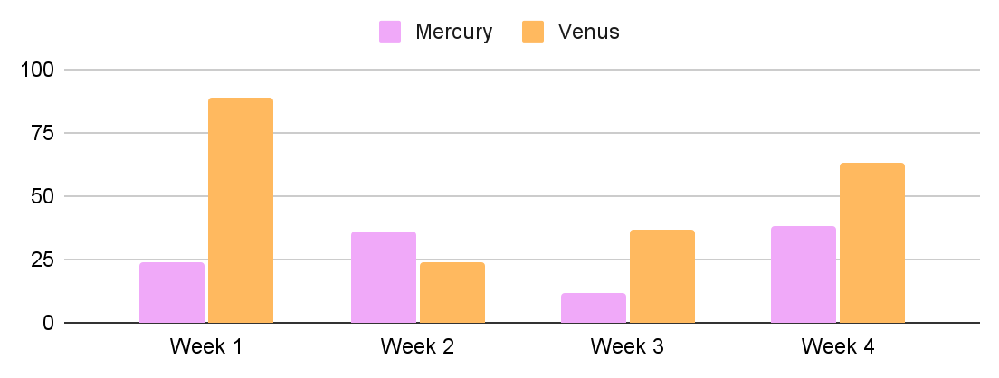
AI Tech Infographics
Mercury
50%
50%
Jupiter
Jupiter is big
Venus
75%
40%
Saturn
Earth
25%
Saturn has rings
-26
+14%
Mercury is the smallest planet
Venus has a toxic atmosphere
Follow the link in the graph to modify its data and then paste the new one here. For more info, click here
This template has been created by Slidesgo

Slide 22
AI Tech Infographics
Dataset
Balanced Dataset
PlantVillage (38 crop-disease categories)
350 images per class (used in some models).
Split
Size
70% train, 20% validation, 10% test
~54K images

Slide 23
AI Tech Infographics
Mercury
Venus
Mercury is the smallest planet of them all
Venus is the second planet from the Sun
50%
20%
This template has been created by Slidesgo

Slide 24
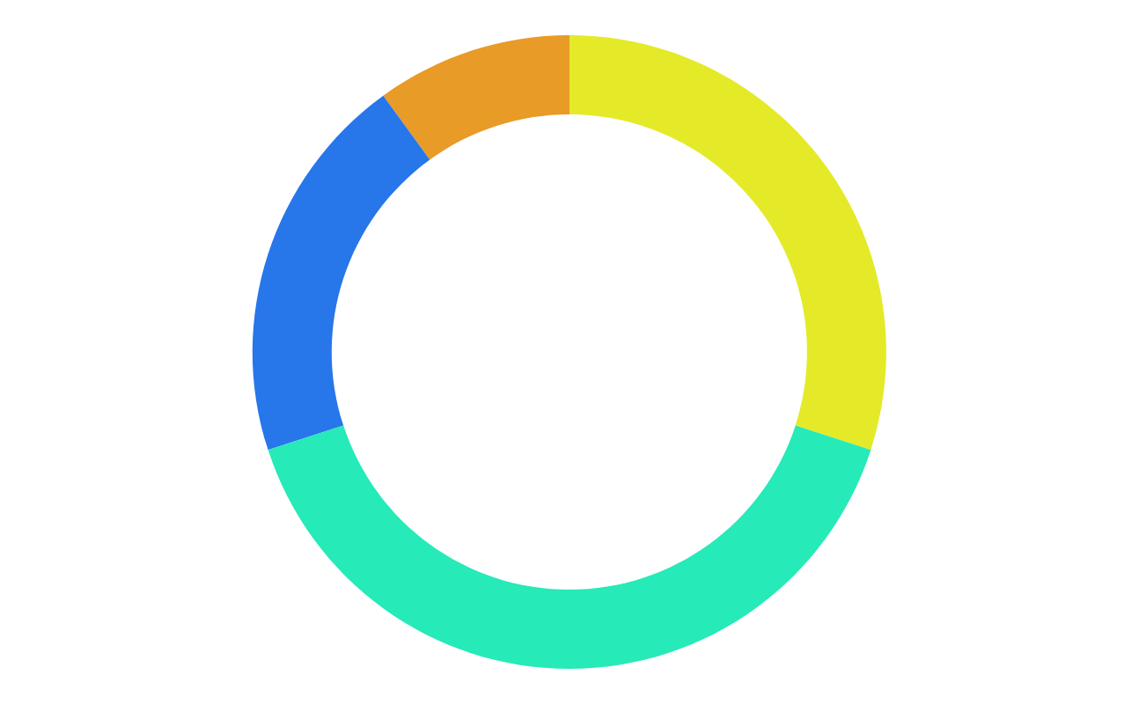
Machine Learning Infographics
10%
30%
Mercury
Jupiter
Mercury is the closest planet to the Sun
Jupiter is a gas giant and the biggest planet
20%
40%
Neptune
Mars
It’s the farthest planet from the Sun
Despite being red, Mars is a cold place
Follow the link in the graph to modify its data and then paste the new one here. For more info, click here

Slide 25
AI Tech Infographics
Week: XX/XX/XX
Team | Mon | Tue | Wed | Thu | Fri | Sat
Mercury | Mercury is small planet
Mars |  |  | Mars is very cold place
Earth |  | Earth is the third planet
Venus |  |  |  | Venus is very hot
Jupiter | Jupiter is big planet
Planning
Research
Meeting
This template has been created by Slidesgo

Slide 26
AI Tech Infographics
01
02
Jupiter
Phase 1
Phase 2
Saturn
Venus
Earth
Mars
Mercury
Neptune
Saturn has a high number of moons
Venus is the second planet from the Sun
Earth is the third planet from the Sun
Despite being red, Mars is very cold
Mercury is the smallest planet of them all
Neptune is the eighth planet from the Sun
This template has been created by Slidesgo

Slide 27
AI Tech Infographics
Earth
Venus
Saturn
Earth
Earth is the third planet from the Sun
Venus
Venus is the second planet from the Sun
Venus
Saturn
Earth
Neptune
Venus
Saturn
Earth
Neptune is the eighth planet from Sun
Jupiter
Jupiter is the biggest planet of them all
Venus
Saturn
Earth
This template has been created by Slidesgo

Slide 28
AI Tech Infographics
Venus is the second planet from the Sun
Neptune is the eighth planet from the Sun
Day 1
Day 3
Day 2
Day 4
Earth is the only planet known to harbor life
Jupiter is the biggest planet of them all
This template has been created by Slidesgo

Slide 29
AI Tech Infographics
Saturn has several rings and a high number of moons, like Jupiter
Checklist 2
Saturn has rings | ✓
We live on earth
Mars is red | ✓
Neptune is big
Pluto is dwarf | ✓
Checklist 1
Mercury is small | ✓
Venus is very hot | ✓
Earth has life
Mars is very cold | ✓
Jupiter is big
Earth is the only planet known to harbor life in the Solar System
This template has been created by Slidesgo

Slide 30
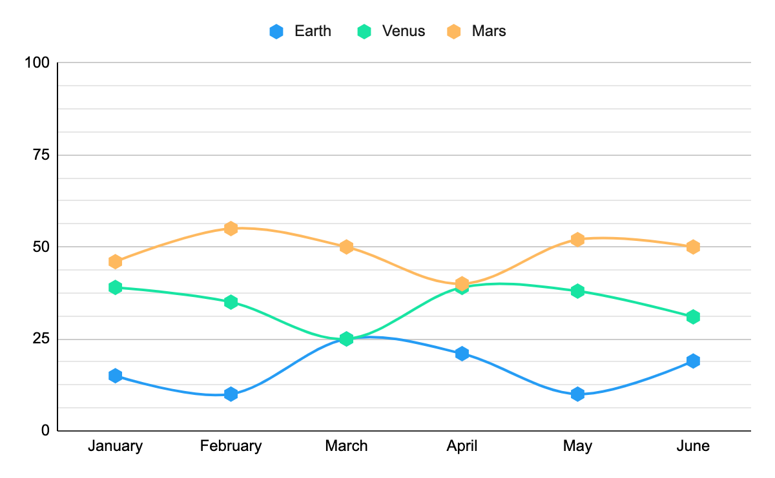
AI Tech Infographics
Periode | Earth | Venus | Mars
January | 15% | 39% | 46%
February | 10% | 35% | 55%
March | 25% | 25% | 50%
April | 21% | 39% | 40%
May | 10% | 38% | 52%
June | 19% | 31% | 50%
Follow the link in the graph to modify its data and then paste the new one here. For more info, click here
This template has been created by Slidesgo

Slide 31
AI Tech Infographics
Earth
Saturn
Mars
Venus
Earth is the third planet from the Sun
Saturn has a high number of moons
Despite being red, Mars is very cold
Venus is the second planet from the Sun
50%
30%
75%
70%
This template has been created by Slidesgo

Slide 32
AI Tech Infographics
A
C
Venus is the second planet from the Sun
Jupiter is the biggest planet of them all
B
Research
D
Earth is the only planet known to harbor life
Neptune is the eighth planet from the Sun
This template has been created by Slidesgo

Slide 33
AI Tech Infographics
2XXX
2XXX
2XXX
2XXX
Earth has human life
Mars is a cold place
Jupiter is big planet
Neptune is far from us
Mercury
Venus
Mercury is the closest planet to the Sun and the smallest of them all
Venus has a beautiful name and is the second planet from the Sun
This template has been created by Slidesgo

Slide 34
Icons Pack

Slide 35
Instructions for use
If you have a free account, in order to use this template, you must credit Slidesgo in your final presentation.
As a Free user, you are allowed to:
Modify this template
Use it for both personal and commercial projects
You are not allowed to:
Sublicense, sell or rent any of Slidesgo Content
Distribute Slidesgo Content unless it has been expressly authorized by Slidesgo
Include Slidesgo Content in an online or offline database or file
Offer Slidesgo templates (or modified versions of Slidesgo templates) for download
Acquire the copyright of
Slidesgo Content
For more information about editing slides, please read our FAQs or visit our blog

Slide 36
Instructions for use (premium users)
As a Premium user, you can use this template without attributing Slidesgo
You are allowed to:
Modify this template
Use it for both personal and commercial projects
Share this template in an
editable format
Hide or delete the “Thanks” slide and the mention to Slidesgo in the credits
You are not allowed to:
Sublicense, sell or rent any of Slidesgo Content
Distribute Slidesgo Content unless it has been expressly authorized by Slidesgo
Use any of the elements that are part in a separated way
Register any of the elements as a trademark or logo in an intellectual property registry
For more information about editing slides, please read our FAQs or visit our blog

Slide 37
Infographics
You can add and edit some infographics to your presentation to present your data in a visual way.
Choose your favourite infographic and insert it in your presentation using Ctrl C + Ctrl V or Cmd C + Cmd V in Mac
Remember to choose the “Keep source formatting” option so that it keeps the design. For more info, please visit our blog
01
07
Select one of the parts and ungroup it by right-clicking and choosing “Ungroup”
Repeat the steps above with the other parts and when you’re done editing, copy the end result and paste it into your presentation
02
06
03
Change the color by clicking
on the paint bucket
05
Group the elements again by selecting them, right-clicking and choosing “Group”
Then resize the element by clicking and dragging one of the square-shaped points of its bounding box (the cursor should look like a double-headed arrow). Remember to hold Shift while dragging to keep the proportions
04

